Slide 1

19CS2211 - Software Engineering
Software Testing Strategies
Session – 19

Slide 2

INTRODUCTION
Software Testing Strategies
describes the steps to be conducted
effort, time, and resources will be required
test planning, test case design, test execution, and resultant data collection and evaluation
flexible enough to promote a customized testing approach.
reasonable planning and management tracking as the project progresses
Testing - process - intent of finding errors prior to delivery to the end user.

Slide 3
What Testing Shows
errors
requirements conformance
performance
an indication
of quality

Slide 4
A Strategic Approach To Software Testing
To perform effective testing - technical reviews
Testing begins at the component level
Different testing techniques
Testing is conducted – by independent group
Testing and debugging are different activities

Slide 5
Verification and Validation
Verification
to ensure that software correctly implements a specific function.
Validation
to ensure task is traceable to customer requirements.
Verification: "Are we building the product right?"
Validation: "Are we building the right product?"

Slide 6
Organizing for Software Testing
Developer:
testing the individual units (components)
ensuring that function behavior for which it was designed.
Independent Test Group (ITG):
remove the inherent problems
removes the conflict of interest
ITG personnel are paid to find errors

Slide 7
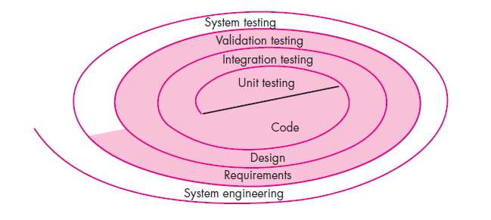
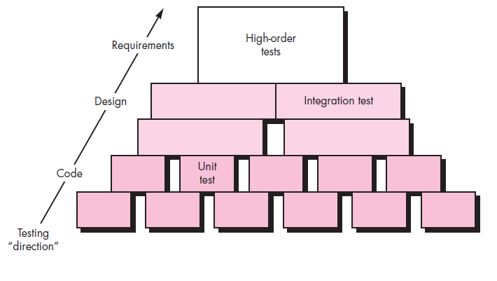
Software Testing Strategy—The Big Picture

Slide 8
Testing Strategy
Begin with “testing-in-the-small” and move toward “testing-in-the-large”
For conventional software
The module (component) is first initial focus
Integration of modules follows
For Object Oriented software
our focus when “testing in the small” changes from an individual module (the conventional view) to an OO class that encompasses attributes and operations and implies communication and collaboration

Slide 9
Strategic Issues
Specify product requirements in a quantifiable manner long before testing commences.
State testing objectives explicitly.
Understand the users of the software and develop a profile for each user category.
Develop a testing plan that emphasizes “rapid cycle testing.”
Build “robust” software that is designed to test itself.
Use effective technical reviews as a filter prior to testing.
Conduct technical reviews to assess the test strategy and test cases themselves.
Develop a continuous improvement approach for the testing process.

Slide 10
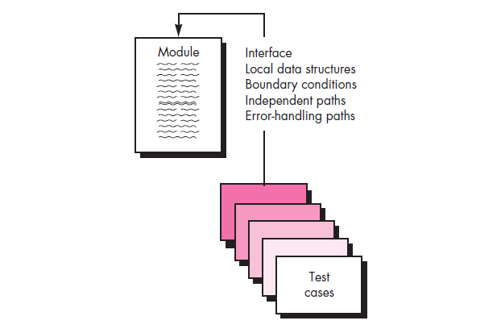
Test Strategies for Conventional Software
A testing strategy incremental view of testing
Unit Testing
Integration Testing
Unit Testing:
Verification on the smallest unit of software

Slide 11
Unit Testing
Verification on the smallest unit of software
Unit-test considerations:
ensure that information properly flows into and out of the program unit under test.
All independent paths through the control structure are exercised to ensure that all statements in a module have been executed at least once.
Boundary conditions are tested to ensure that the module operates properly at boundaries established to limit or restrict processing.
All error-handling paths are tested.

Slide 12
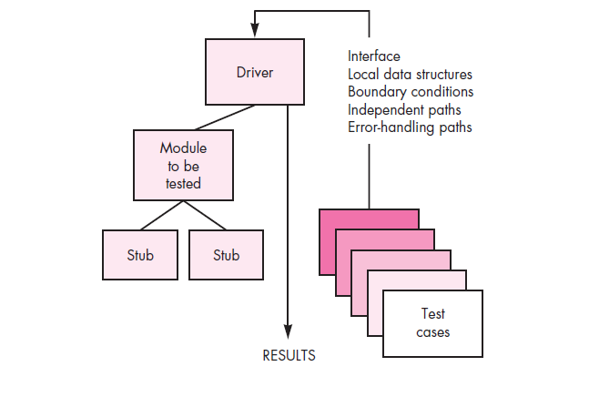
Unit-test Procedures
Unit testing is normally considered as an adjunct (i.e., extra) to the coding step.
The design of unit tests can occur before coding begins or after source code has been generated.
A review of design information provides guidance for uncovering.

Slide 13
Integration Testing
It is a systematic technique for constructing the software architecture
To uncover errors associated with interfacing.
The objective is to take unit-tested components and build a program structure that has been dictated by design.
Top-down integration:
Top-down integration testing is an incremental approach
Modules are integrated by moving downward through the control hierarchy, beginning with the main control module(main program).
Modules subordinate (and ultimately subordinate) to the main control module are incorporated into the structure in either a depth-first or breadth-first manner

Slide 14
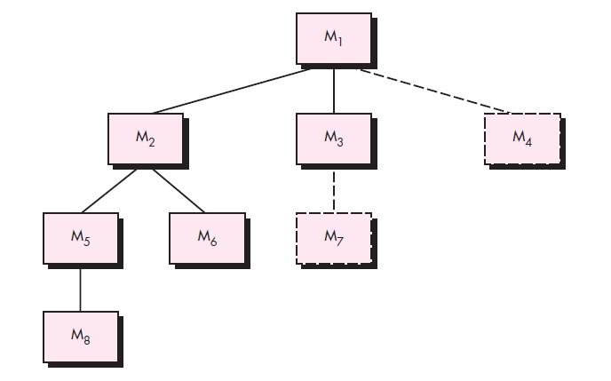
Depth-first integration integrates all components on a major control path of the program structure.

Slide 15
The integration process is performed in a series of five steps:
1. The main control module is used as a test driver and stubs are substituted for all components directly subordinate to the main control module.
2. Depending on the integration approach selected (i.e., depth or breadth first), subordinate stubs are replaced one at a time with actual components.
3. Tests are conducted as each component is integrated.
4. On completion of each set of tests, another stub is replaced with the real component.
5. Regression testing (discussed later in this section) may be conducted to ensure that new errors have not been introduced.
The process continues from step 2 until the entire program structure is built.

Slide 16
Bottom-up integration:
begins construction and testing with atomic modules (i.e., components at the lowest levels in the program structure). 1. Low-level components are combined into clusters (sometimes called builds) that perform a specific software subfunction. 2. A driver (a control program for testing) is written to coordinate test case input and output. 3. The cluster is tested. 4. Drivers are removed and clusters are combined moving upward in the program structure.

Slide 17
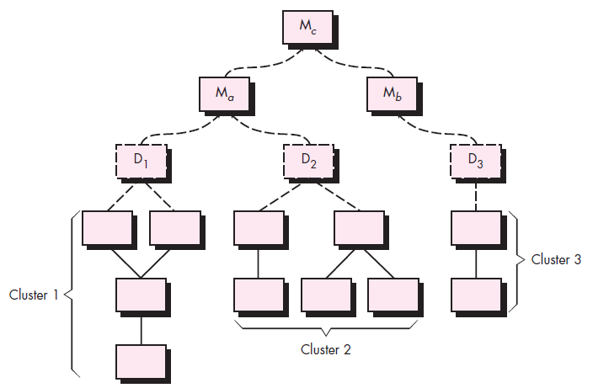

Slide 18
Regression Testing
Each time a new module is added as part of integration testing, the software changes.
New data flow paths are established, new I/O may occur, and new control logic is invoked.
These changes may cause problems with functions that previously worked flawlessly.
In the context of an integration test strategy, regression testing is the re-execution of some subset of tests that have already been conducted to ensure that changes have not propagated unintended side effects.

Slide 19
Smoke Testing
Smoke testing is an integration testing approach that is commonly used when product software is developed.
Designed for time-critical projects, allowing the software team to assess the project on a frequent basis.

Slide 20
The smoke-testing approach encompasses the following activities:
Software components -> code -> data files, libraries, reusable modules, and engineered components
Series of tests is designed - to expose errors.
The build (product) is integrated with other builds, and the entire product (in its current form) is smoke tested daily.
The integration approach may be top down or bottom up.

Slide 21
Benefits of Smoke Test:
Integration risk is minimized.
The quality of the end product is improved.
Error diagnosis and correction are simplified.
Progress is easier to assess.

Slide 22
Revision Questions
Define Software Testing.
2. Explain A Strategic Approach To Software Testing in detail
Sketch how testing strategy is represented in spiral model and explain.
Explain in detail about Testing Strategy.
List out the Strategic Issues of Software testing.
Explain Smoke Test in detail.

Slide 23
Thank You

